Slide 1

INFO 5502: Principles and Techniques of Data Science
Devi Nageswari Kondeti (11565319)

Slide 2
Final Project
Human Activity Recognition Classification using Machine Learning

Slide 3
Table of Contents
Introduction
Design and Architecture
Implementation
Exploratory Data Analysis
Implementation using Machine Learning
Machine Learning Models
Conclusion and Future

Slide 4
1. INTRODUCTION
Human Activity Recognition (HAR) is from a sensor data which can be very useful in developing assistive technology for applications like daily activity monitoring elderly and physically impaired people.
The basic six activities (walking, walking upstairs, walking downstairs, sitting, standing, laying) can create constructive feedback for numerous disease monitoring systems.
A data analysis technique called machine learning automates the creation of analytical models. It is a subfield of artificial intelligence founded on the notion that machines are capable of learning from data, seeing patterns, and making judgments with little assistance from humans.

Slide 5
Problem Statement
The objective is to classify the activities performed in one of the six activities based on reading obtained from the accelerometer and gyroscope.
Description
The Human Activity Recognition Dataset was created through trials with 30 volunteers, aged between 19 and 48, who carried out daily activities while wearing a smartphone attached on their waist, including walking, going upstairs, downstairs, sitting, standing, and lying down (Samsung Galaxy S II).
3-axial linear acceleration and 3-axial angular velocity at a rate of 50Hz were recorded using the integrated accelerometer and gyroscope. The experiments were videotaped so that the data could be manually labeled. The obtained dataset was then split into two sections at random; information from 70% of the population was chosen to create the training data, and information from the remaining 30% was utilized to create the test data.

Slide 6
2. DESIGN AND ARCHITECTURE
Collecting the data
Pre-processing the data
Designing the data model
Generating and visualizing the results

Slide 7
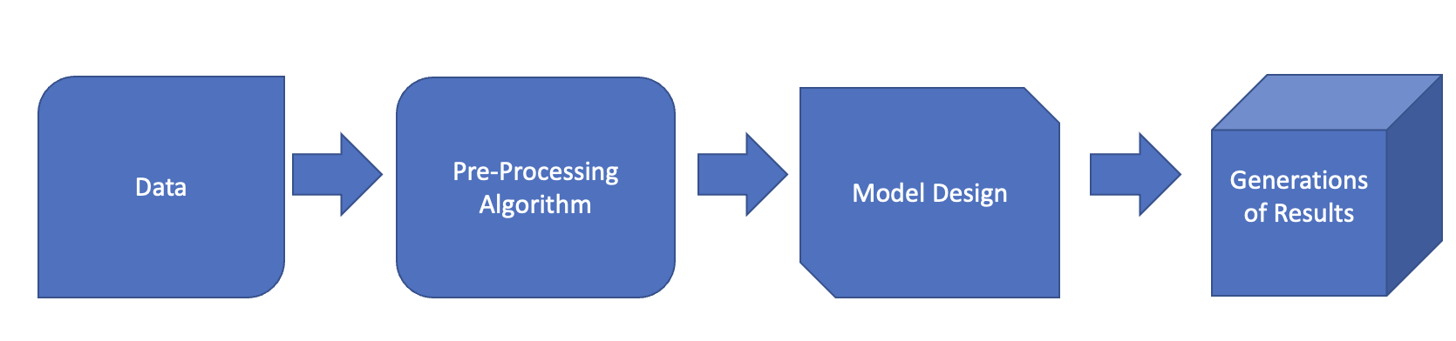

Slide 8
Implementation - Hardware and Software Requirements
The minimum hardware requirements are 8 GB RAM, a dual-core CPU, and a 64-bit operating system (Windows/Linux).
Jupyter Notebook with Anaconda is the Integrated Development Environment (IDE) utilized in this project. You can use it to create and execute machine learning code. The programming language chosen for this project is Python.

Slide 9
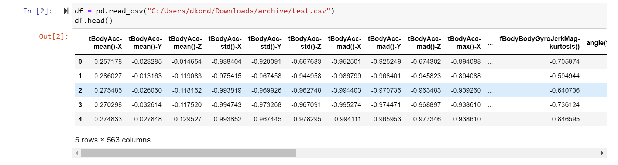
1. Exploratory Data Analysis
Reading the CSV file and this is how the data looks:

Slide 10
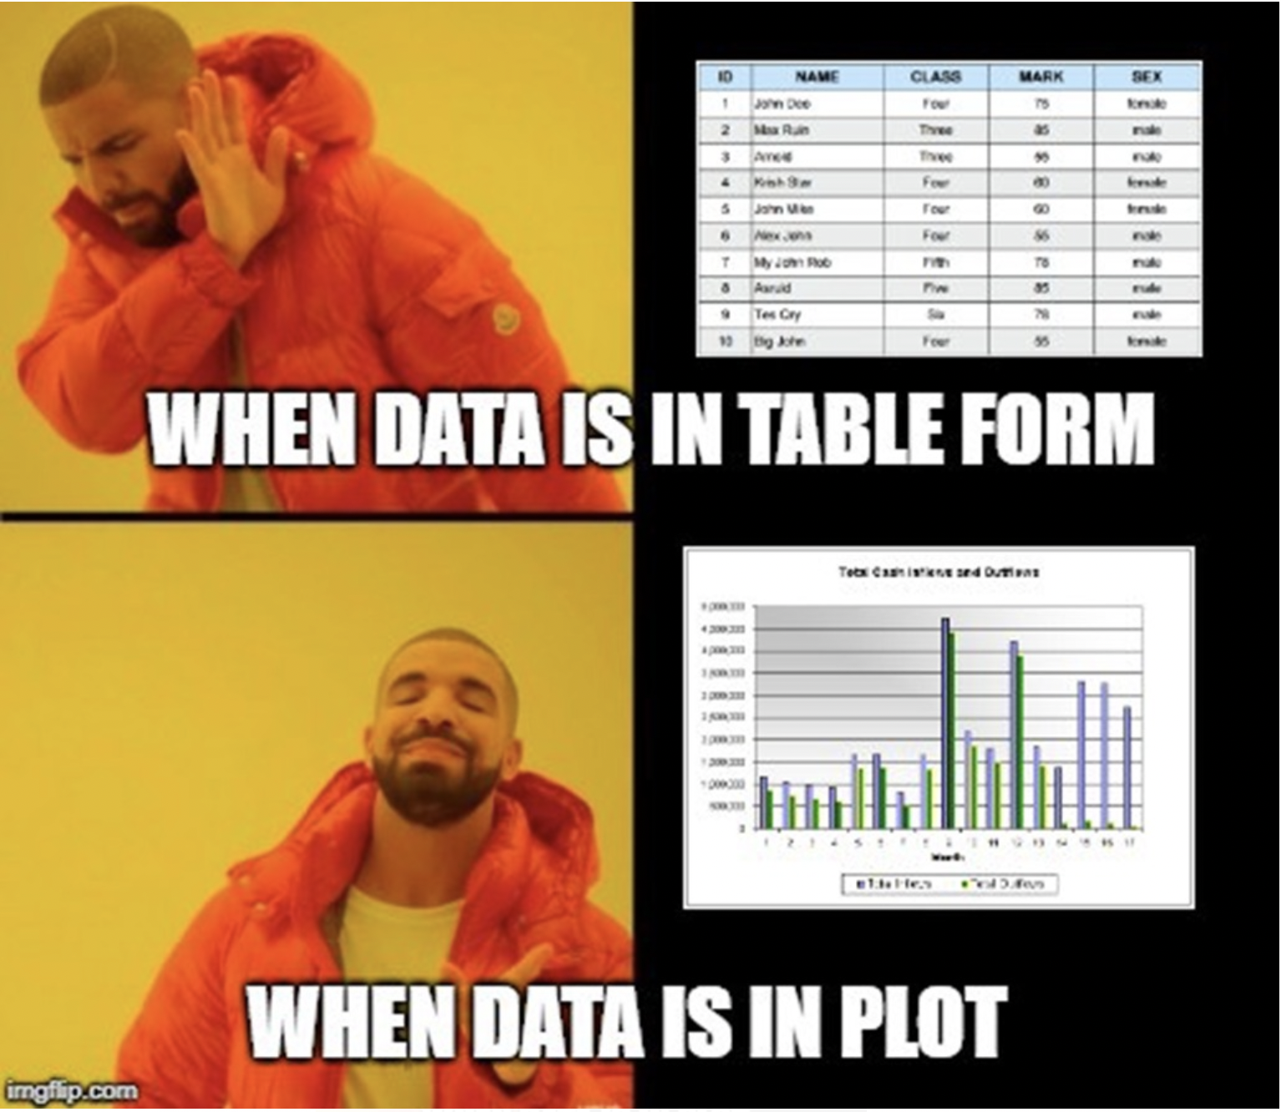

Slide 11
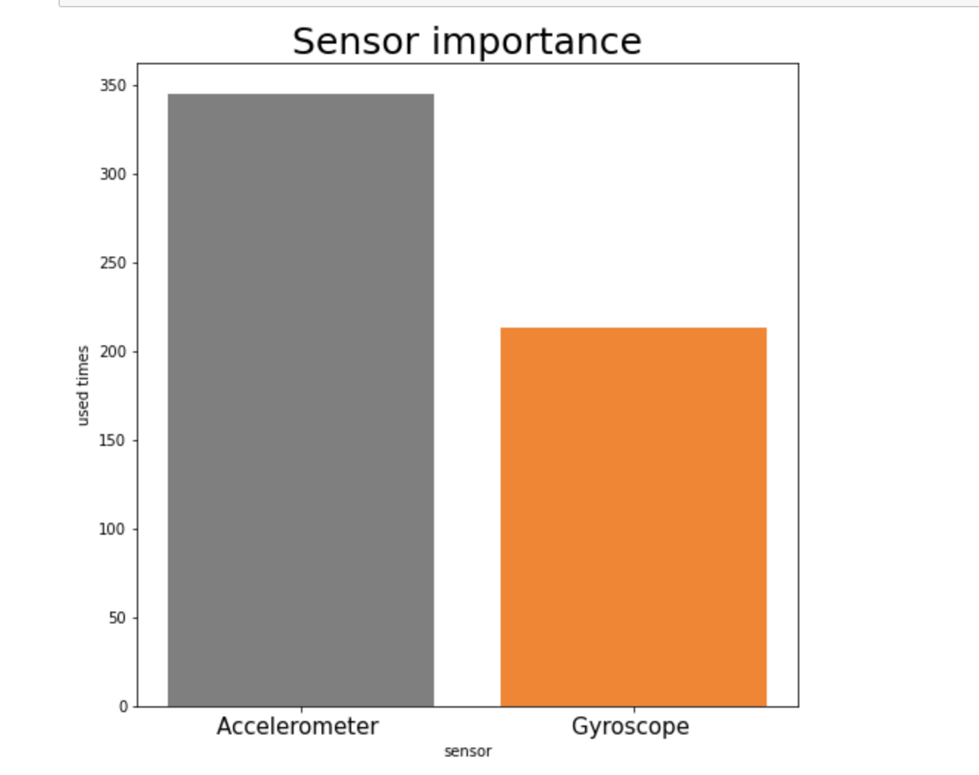
Finding the right sensor essential for categorizing participants based on their walking style.
We have plotted the graph between the sensors and number of times used by user to find the right sensor
From the analysis we can easily define that the most widely used sensor is accelerometer.

Slide 12
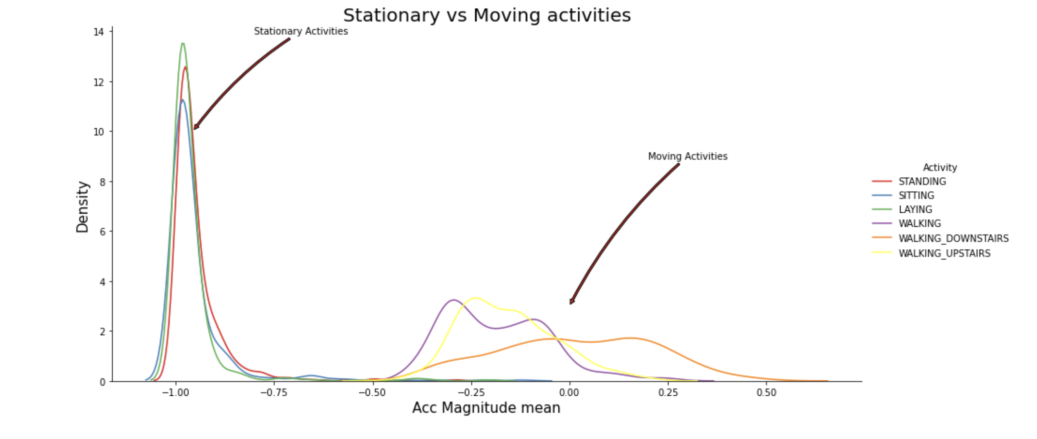
Checking for differences between Stationary and Moving activities
We have plotted this graph to show that Stationary activities are completely different from Moving activities.
Here, we can clearly see that the distribution of stationary activities is greater than that of the moving activities.

Slide 13
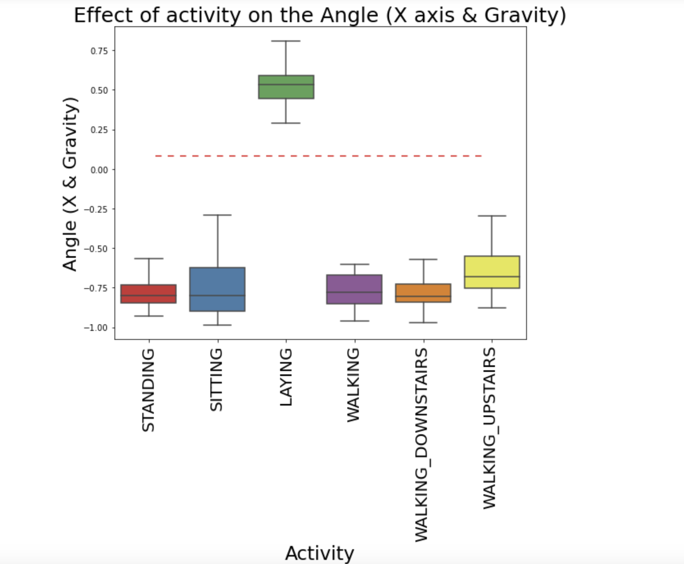
Examining the relationship between X- axis and Gravity Mean
From the observation, we can say that if angle X, gravity mean is greater than zero, then Activity is Laying.
With just one if else statement, we can categorize all the datapoints belonging to Laying activity.

Slide 14
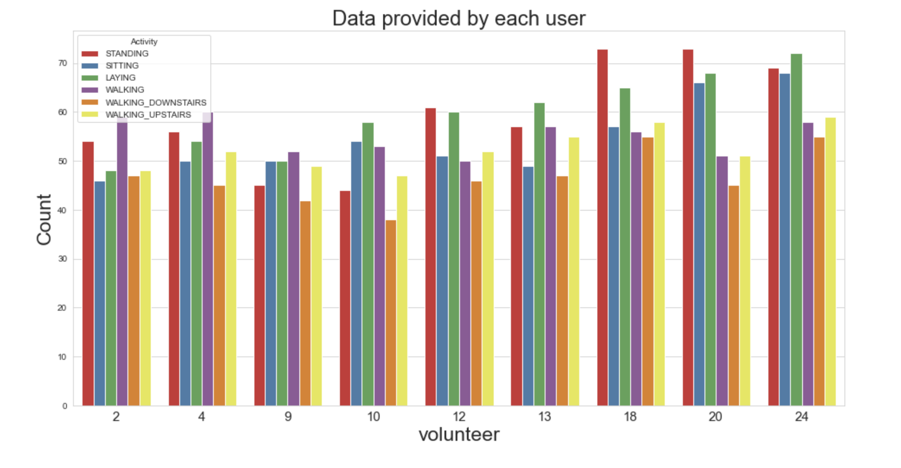
Checking for Data imbalance
Here, we have plotted the data provided by each user
As per graph, we can see that we have received nearly the same amount of reading across all the subjects, indicating that there are no significant differences in reading, therefore we shouldn't be concerned.

Slide 15
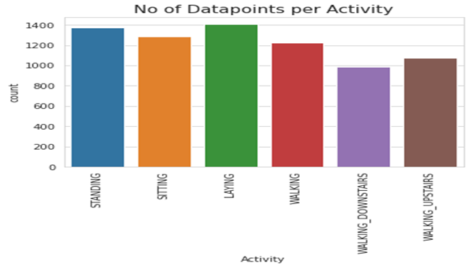
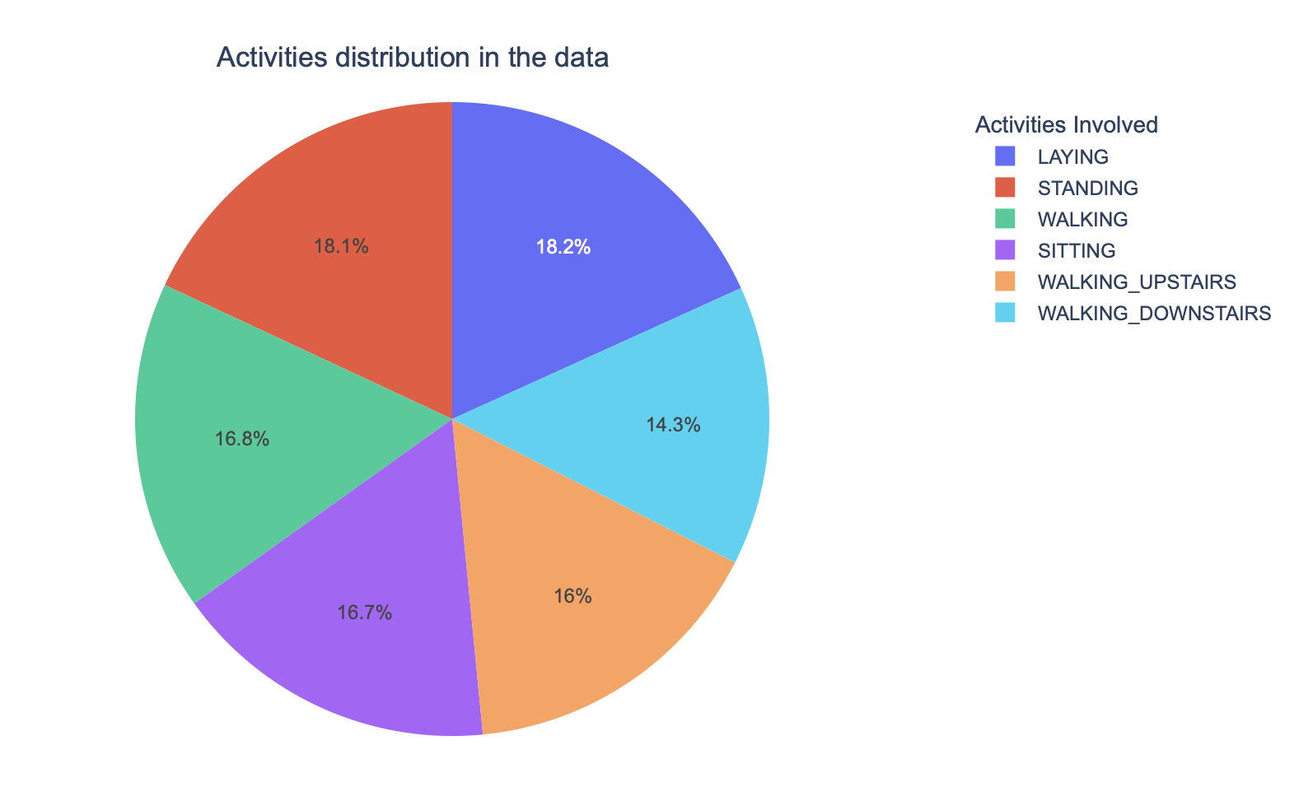
Here, we have plotted the graph for number of datapoints per activity and showing activities distribution in the data using pie chart.
As per observation, we will not conduct resampling because the data is balanced.

Slide 16
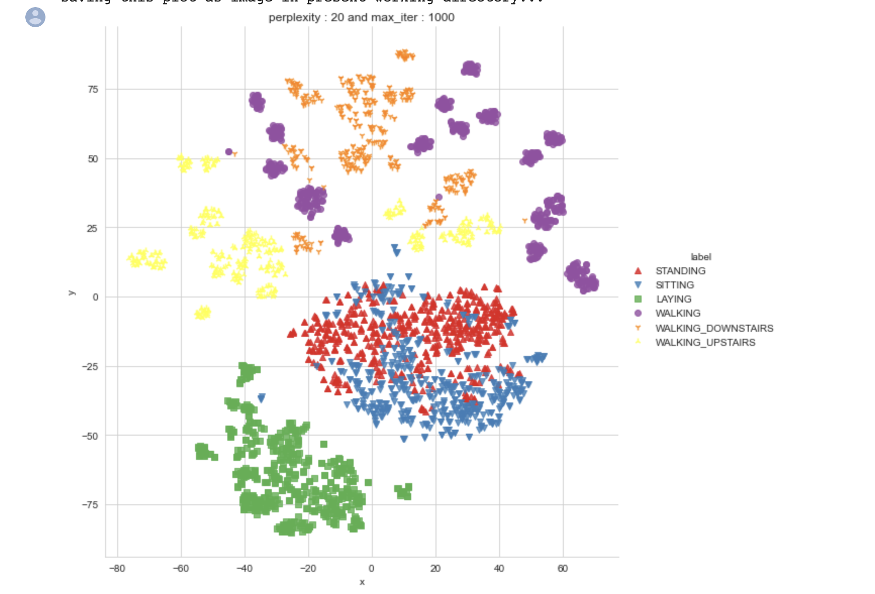
Machine Learning Models – 1. Unsupervised Learning Model: Using t-sne (t-Distributed Stochastic Neighbor Embedding) for visualization of data
We can clearly see that all the features can be easily separated except standing and sitting.
This model is likely to be unable to distinguish between standing and sitting

Slide 17
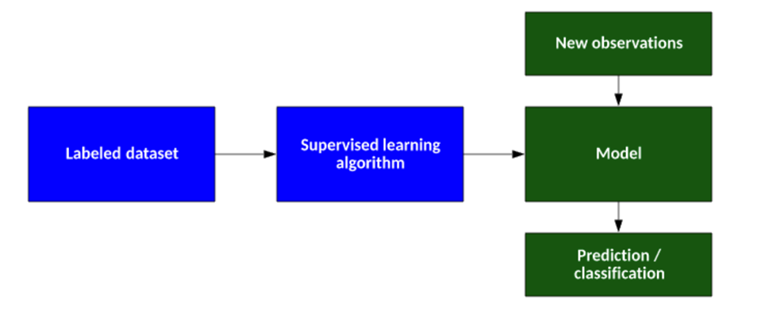
Machine Learning Models – 2. Supervised Learning Model:
Supervised learning is a method by which you can use labeled training data to train a function that you can then generalize for new examples. The training involves a critic that can indicate when the function is correct or not, and then alter the function to produce the correct result. Classical examples include neural networks that are trained by the back-propagation algorithm, but many other algorithms exist.

Slide 18
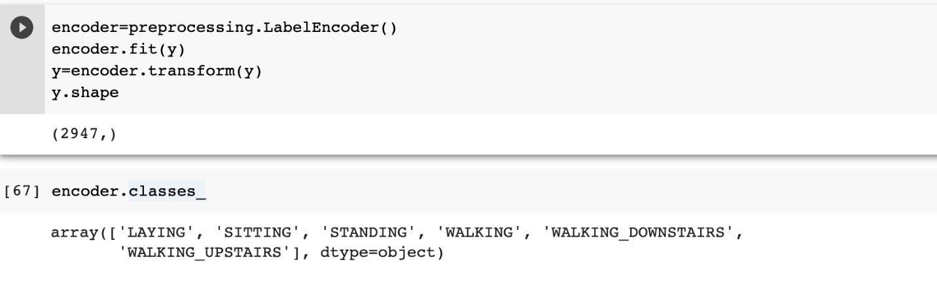
Conversion of Categorical labels into numerical:
Categorical features refer to string data where machines cannot interpret the categorical data directly. Therefore, the categorical data must be converted into numerical data for further processing. Here we used LabelEncoder() from sklearn library to convert categorical data to numerical data.

Slide 19
Supervised Learning Models
1.Support Vector Machine(SVM)
2.Random Forest Classifier
3.Confusion Matrix
4.Decision Tree Classifier

Slide 20
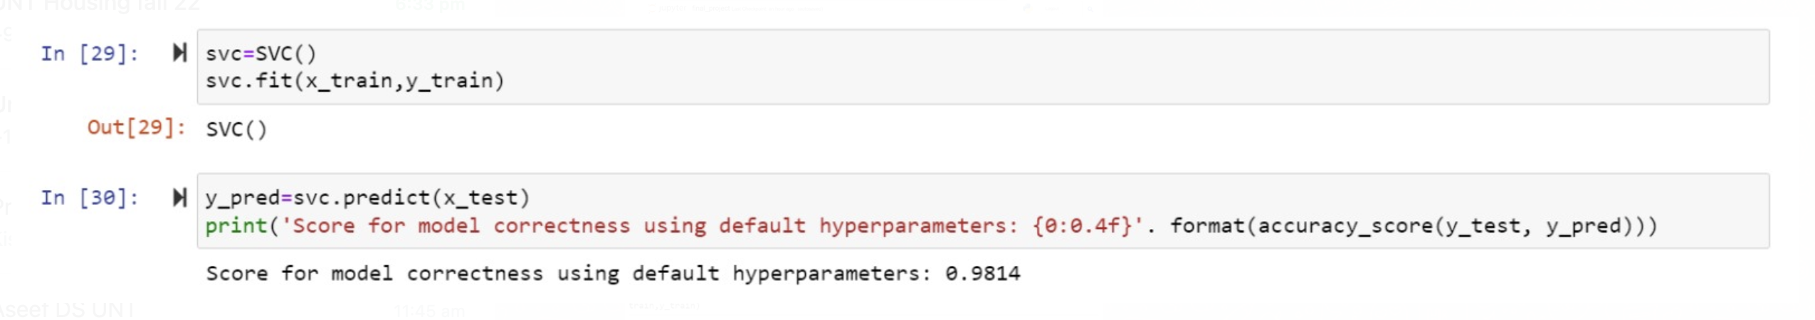
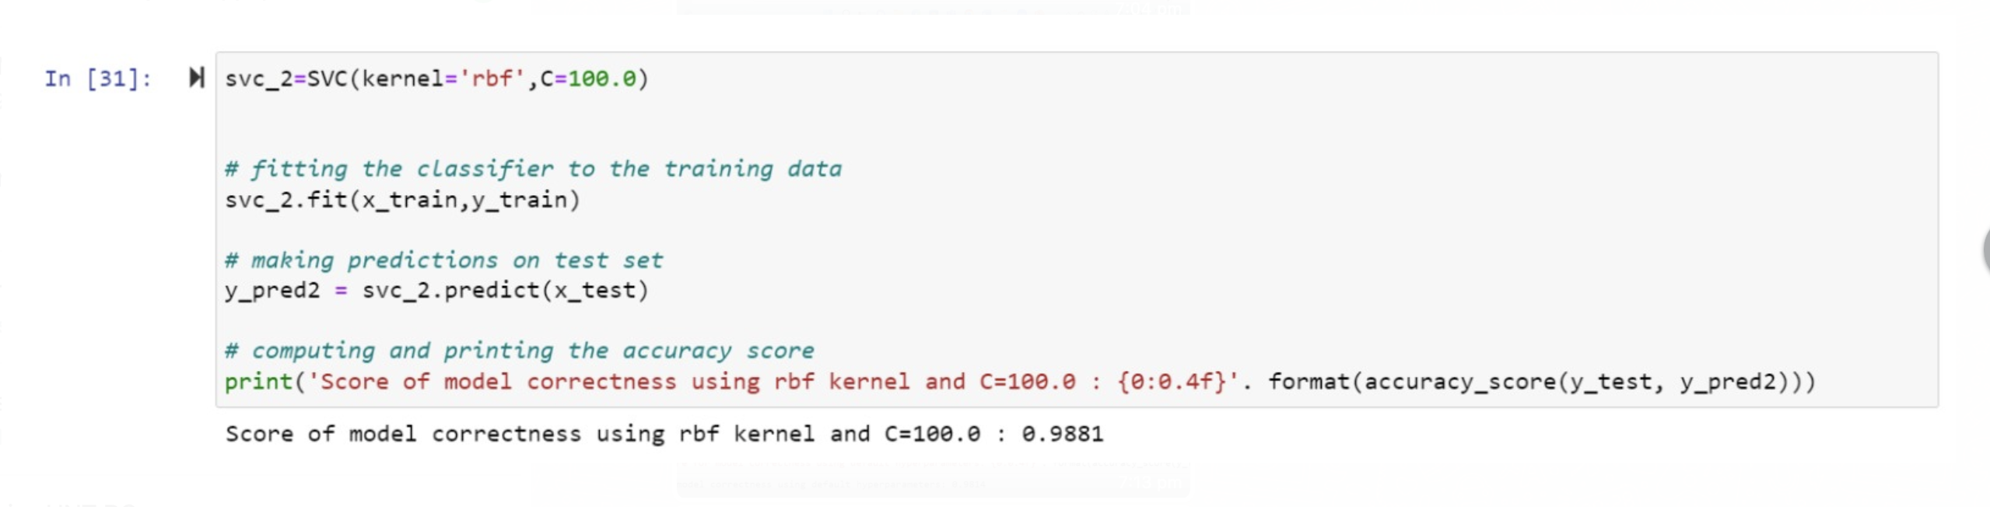
Support Vector Machine (SVM):
Support vector machines are strongly advised since they provide notably accurate results while consuming less computing power.
Both regression and classification applications can benefit from the usage of SVMs, or Support Vector Machines. It is, nonetheless, widely used to achieve categorization goals. The goal of the SVM algorithm is to locate a hyperplane in an N-dimensional space that distinctly classifies the data points

Slide 21
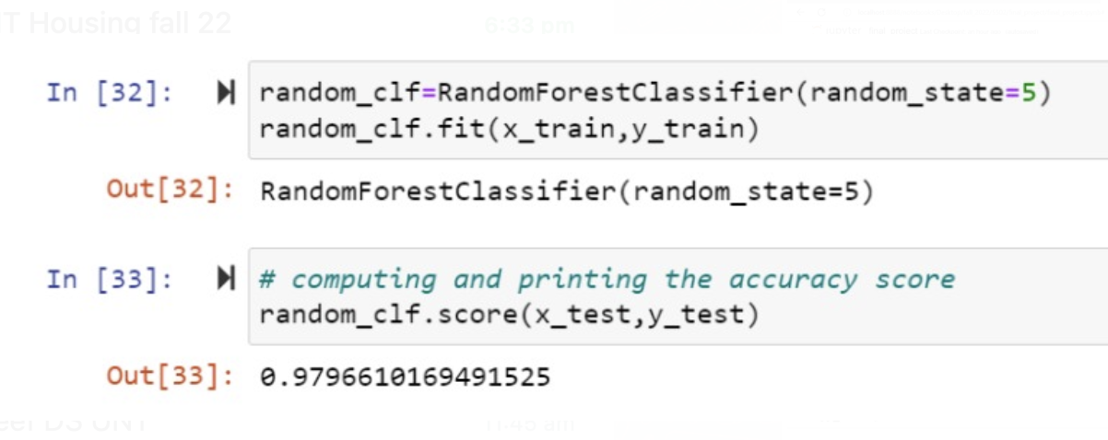
Random Forest Classifier
Random forest is a popular supervised machine learning technique for classification and regression issues. The bulk of the samples are used for classification, and the average of the samples is used for regression, in order to create decision trees.

Slide 22
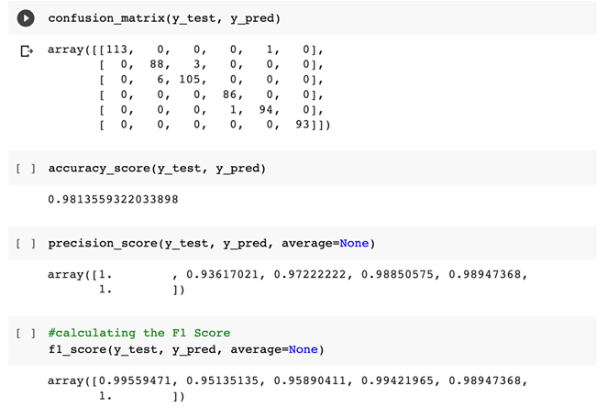
Confusion Matrix
A confusion matrix is a table that is used to define the performance of a classification algorithm. A confusion matrix visualizes and summarizes the performance of a classification algorithm

Slide 23
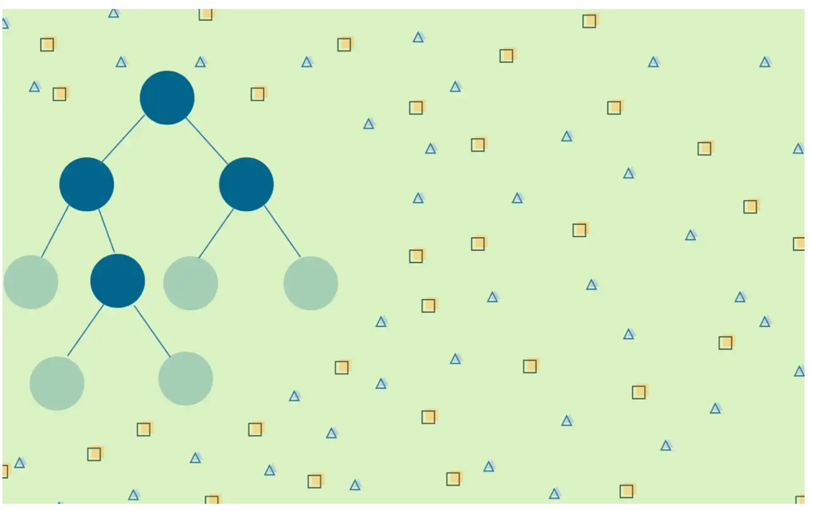
Decision Tree Classifier:
Decision Trees are supervised learning techniques that may be used to address regression and classification problems as well as function well with classifiers. It is a tree-structured classifier, with each leaf node denoting the classification result and inner nodes denoting the properties of a dataset.

Slide 24
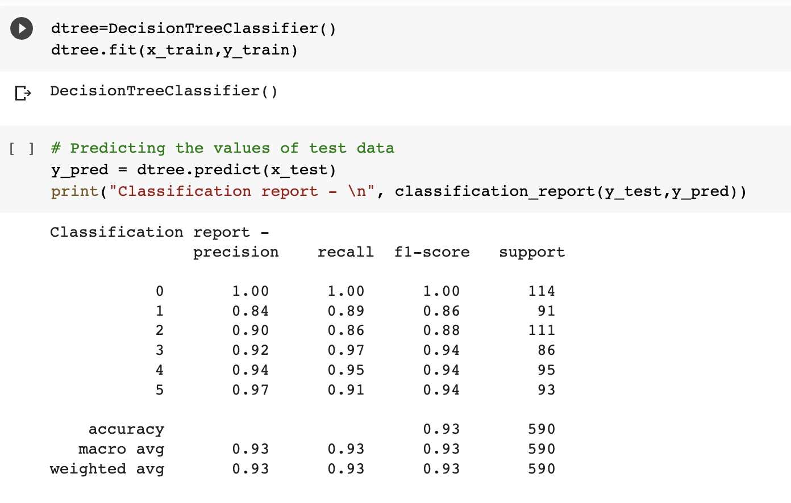
CONCLUSION AND FUTURE
The performance was improved by the expert-generated features. It demonstrates the significance of domain expertise in obtaining more effective models. Feature generations can help in better detection in future.

Slide 25
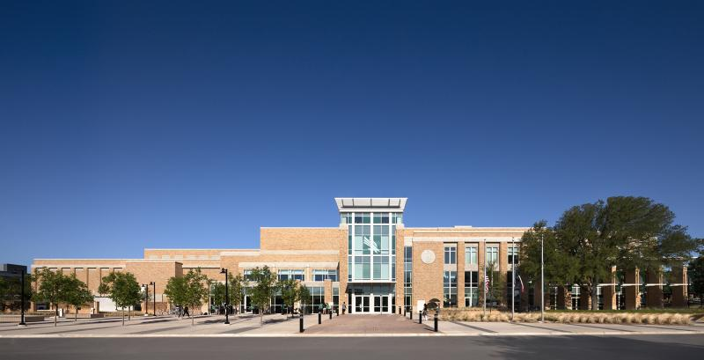
Thank You !

